Slide 1
The AWS Step Functions Workshop
Notes:
Hello my name is Dan Fox and I’m a Principal Specialist Solutions Architect at AWS. Welcome to the AWS Step Functions Workshop. Thank you for participating.
In this workshop you will learn the primary features of AWS Step Functions through a series of hands on modules. Step Functions is a really exciting service, and it generates a lot of talk value among my colleagues both within AWS and outside of it. I know many of my peers in the Solution Architect community at AWS think of step functions as a paradigm shift in software development, offering a new top layer of abstraction for cloud native applications.
This is a hands on workshop and it does get to the code level, but coding experience is not necessary to be successful today. If you haven’t coded in a while, or even if you’ve never coded you will still feel successful at the end of this session of you engage with the materials.
If you’re seeing this video in YouTube you should find a link to the workshop materials in the notes below. In order to participate in this workshop you will need an AWS account. If you’re at an AWS hosted event, you may be provided with a temporary AWS account. If you are choosing the self service option, you will follow the instructions to deploy the workshop materials into your own account.
This workshop may be run in either a hosted or self-service mode. In an AWS hosted event you may be provided with a temporary, free AWS account with the workshop materials previously deployed and configured. You can request a hosted event from your AWS account team.
In self-service mode, you will deploy the workshop materials to your own AWS account through CloudFormation templates. For self-service participants, set up and clean up instructions are provided at the beginning and end of each module. The workshop itself is free. The only costs to you are the costs of the resources deployed in your AWS account. If you follow the cleanup instructions, those costs should be less than dollar for the entire workshop.
So with that, let’s jump right in.

Slide 2
Agenda
Step Functions overview presentation
Hands-on workshop
Notes:
Here’s a quick overview of our session together today. I’ll provide a high level overview of Step Functions.
Then we will transition to a series of hands on workshop labs. Each participant of this builders session will be given their own, temporary, free AWS account. These accounts are preconfigured to contain our lab assets so please us the account we give you today and not your own account.
The workshop contains 10 modules and is designed to teach you primary features of Step Functions.
The duration of this session is one hour.

Slide 3
Signs you might need an orchestration service
Do you have an application that spans multiple AWS services?
Is the sequence of service interaction important?
Does your application manage state between AWS service calls?
Do you have application workflow that requires human intervention?
Does your application contain workflow patterns like decision trees, branching logic, parallel processing, retries, and error handling?
Yes? You might benefit from Step Functions!
Notes:
Let’s talk about signs that might indicate that you need an orchestration service.
If the answer to any of these questions is yes, then you might benefit from Step Functions.

Slide 4
Common orchestration patterns
“I want to sequence tasks”
“I want to retry failed tasks”
“I want to run tasks in parallel”
A
B
A
A
B
C
“I want to select tasks based on data”
“I want try/catch/finally”
A
B
?
C
Notes:
What are some of the most common orchestration patterns that we see in applications?
You may want to sequence your tasks. For example, you need to perform fraud detection, then based on the results you can approve or deny a transaction.
You may want to retry failed tasks. For example, you may have a downstream service that occasionally fails. You may want to implement retry intervals, maximum attempts, and backoff rates.
You may want to run tasks in parallel. For example, a customer purchase could trigger services for accounting, inventory, fulfillment and shipping
You may want to select tasks based on the data you receive. For example, you may have user generated data that has different processing and storage requirements based on its country of origin.
You may want to implement a try / catch / finally flow control pattern in your application.

Slide 5

Introducing AWS Step Functions
Low-code visual workflow service
Provides orchestration for other AWS services
Supports common workflow patterns
Simplifies implementation of common tasks so developers can focus on higher-value business logic
Notes:
If service orchestration seems useful to you then you might benefit from AWS Step Functions.
What is the the Step Functions service?
AWS Step Functions is a low-code visual workflow service that can provide orchestration for AWS services
Step functions supports many common workflow patterns like retries, error handling, parallel processing, branching logic, service integrations, and observability.
Step Function simplifies the implementation of these common tasks so developers can focus on higher-value business logic.
Step Functions can be used in a wide variety of applications including data processing, machine learning, microservice orchestration and IT and security automation. Some people even use step functions as a CI/CD pipeline.

Slide 6
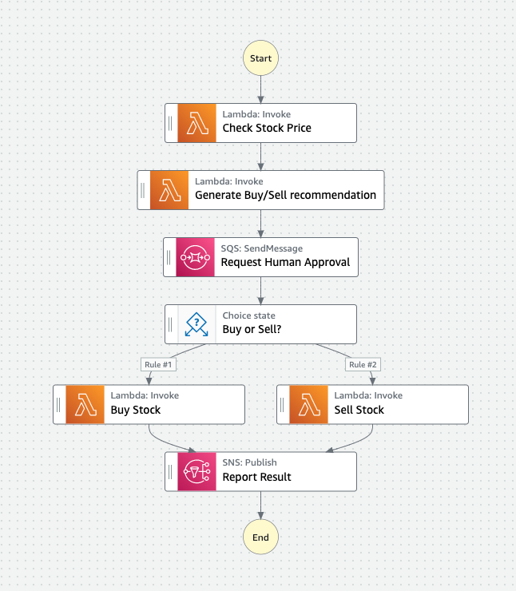
Step Function Workflows
Are written using Amazon States Language (ASL)
Are defined as state machines
Are composed of steps called states
Can be used to orchestrate multiple AWS services
Notes:
Let’s talk about some of the primary concepts within Step Functions. The first one we’ll cover is the concept of workflows. What is a workflow in Step Functions?
A workflow is a map of all of the logical pathways that can be executed within an application.
In step functions workflows are written using a syntax called Amazon States Language or ASL. We’ll be learning more about ASL later in this session.
Workflows often referred to as state machines.
State machines are composed of steps called states.
And state machines can be used to orchestrate multiple AWS services.

Slide 7
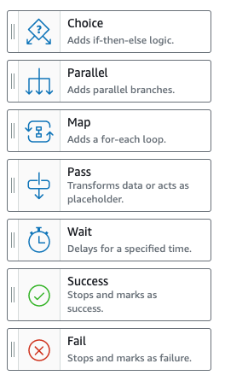
Step Function States
States can perform a variety of actions in your state machine:
State | Action
Choice | make a choice between branches of execution
Parallel | begin parallel branches of execution
Map | dynamically iterate steps
Pass | simply pass its input to its output or inject some fixed data
Wait | provide a delay
Succeed or Fail | stop an execution with a failure or success
Task | do some work
Notes:
Each step within a workflow is called a state. A typical workflow will be composed of multiple states. Each state type is designed to perform a specific kind of action.
In a single execution, a state machine will begin at an initial state, that state will execute some kind of action, and then it will pass control to the next state in the sequence. That state will then execute its action, and then pass control forward again. And so on and so on.
The workflow will continue to progress from state to state until it reaches an end state. After which it will stop execution.
This is a list of the primary state types within step functions.
The choice state enables branching logic within your state machine.
The parallel state enables concurrent branches of execution.
The map state enables you to create dynamic pathways based on input data.
The pass state passes the flow control onward, but it can also provide some simple data transformation.
The wait state provides a delay function.
Succeed or fail states stop an execution with failure or success.
And the task state is an instruction to do some work.

Slide 8
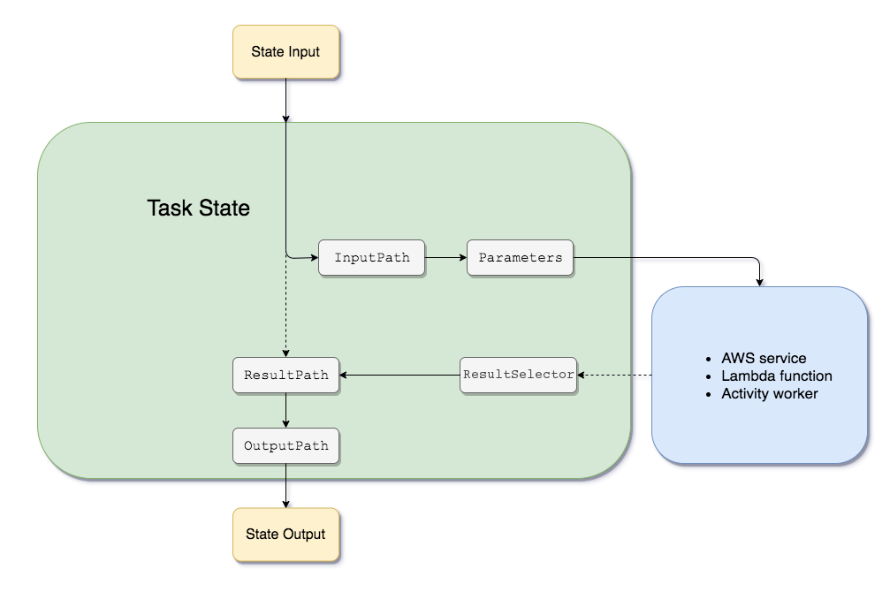
Input and Output Processing
A Step Functions execution receives a JSON text as input and passes that input to the first state in the workflow.
Individual states receive JSON as input and usually pass JSON as output to the next state.
ASL provides tools to filter, manipulate and transform input and output between states.
Notes:
Read slide.
We are not going the specifically cover the input and output processing features in the workshop today, but you should be aware that you can pass data from state to state throughout an entire workflow and this concept of input and output processing between workflow steps is a well supported feature of Step Functions.

Slide 9
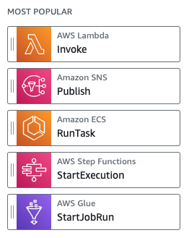
AWS SDK Service Integrations
Step Functions integrates with 200+ supported AWS Services
Step Functions supports 9,000+ API Actions
Integration syntax:
Example integration:
Notes:
One of the most interesting feature launches for step functions occurred just a little while ago.
On Sept 30, Step Functions expanded the number of supported AWS Services from 17 to over 200 and AWS API Actions from 46 to over 9,000.
Step functions has a very simple syntax for integrating services and api’s which you can see here.

Slide 10
Standard vs. Express workflows
 | Standard | Express
Use Cases | Ideal for long-running, durable, and auditable workflows. | Ideal for high-volume event-processing workloads.
Maximum duration | 365 days | 5 minutes
State Transitions | 5,000 initial bucket with 1,500 per second refill rate | Unlimited
Patterns | Supports all patterns | Does not support Job-run (.sync) or Callback (.wait For Callback)
Invocation | Asynchronous invocation only | Asynchronous and synchronous invocation
Pricing | $0.025 per 1,000 state transitions | $1.00 per 1M requests + $0.06 per GB-hour (tiered)
Notes:
Step Functions has two workflow types. Standard workflows are designed to support long-running, durable and auditable workflows. These could be workflows that may need to durably take long pauses, possibly even require human interventions.
Express workflows are designed for high volume event processing such as IoT data ingestion, streaming data processing, and mobile application backends.
You can see some of the differences between the two workflow types in this table. Most notable here is that a standard workflow can continue execution for up to one year, while an express workflow is limited to 5 minutes.
With regard to state transitions, the standard workflow supports an initial bucket of 5,000 with a 1500 per second refill rate. While express workflows support an unlimited amount of state transitions.
Each workflow type has differing quotas and supported features, you can explore these in the Step Functions documentation.

Slide 11
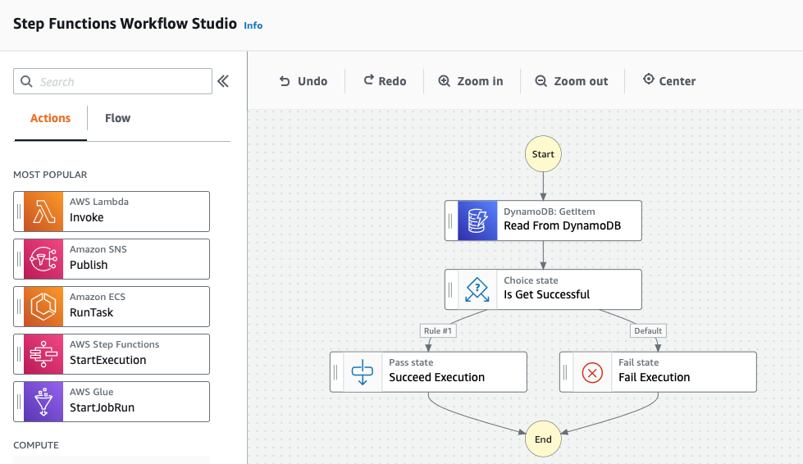
Workflow Studio
Low code visual editor for designing workflows
Notes:
One other interesting Step Functions feature worth learning about is the the WorkFlow Studio. Workflow Studio is a low code visual editor for designing workflows. You can find it in authoring mode when you’re creating or editing a workflow. With Workflow Studio you can drag and drop integrations and flow choices to form complex application logic. We’ll set aside some time in today’s workshop to review this useful editor.

Slide 12
Task Patterns
Step Functions will call a service integration and proceed immediately without waiting for the service to complete its job.
Request Response
Step Functions will call a service integration and wait until its job is complete.
Sync Polling
Step functions will call a service with a task token and proceed after the token is returned.
Callback
Notes:
And finally task patterns. These task patterns are where we’ll be spending most of our time today. When you create a task with Step Functions by calling any of over 200 integrated services, there are 3 patterns that you can use for integration. The first pattern is called request response. When you use this pattern Step Functions proceeds immediately to the next step of the workflow without waiting for the service to complete it’s job.
The second pattern is called sync polling. When you use this pattern, Step Functions will monitor the underlying service and only proceed to the next step in the workflow when the service completes it’s job.
The last pattern is the callback pattern. With this pattern step functions provides a task token to the integrated service, then only proceeds to the next step in the workflow after the token is returned. All right let’s jump in.

Slide 13
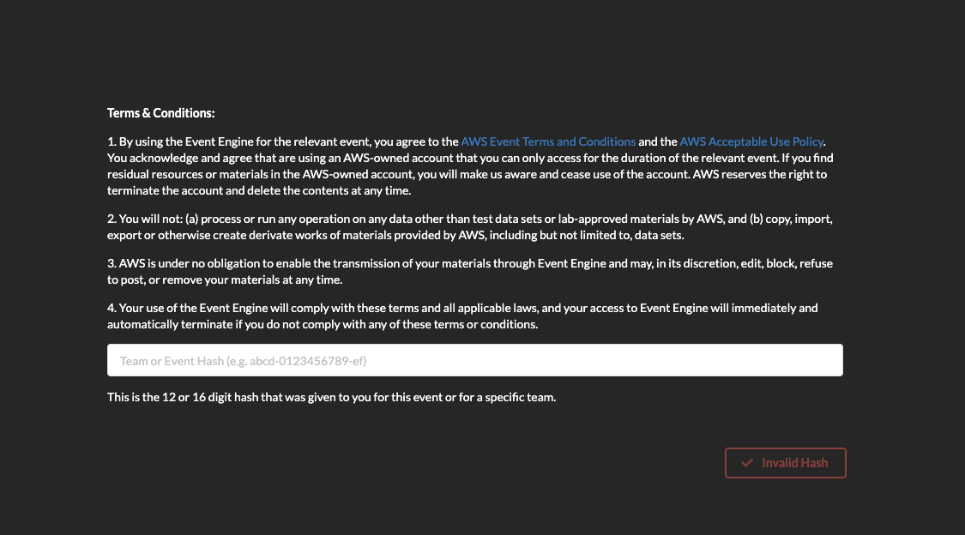
Dashboard Login
https://dashboard.eventengine.run
Event Hash: 577b-1e91452a24-62

Slide 14
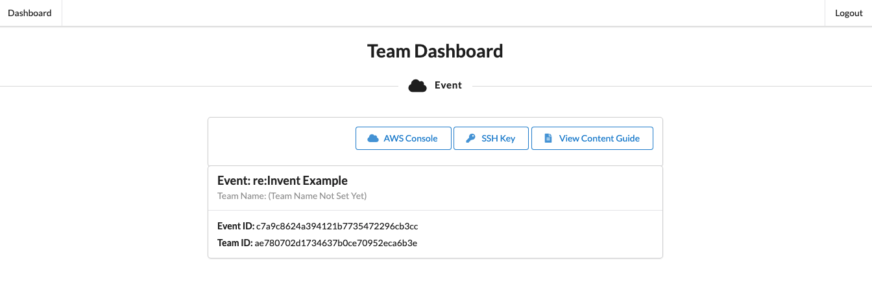
Accessing Workshop Content

Slide 15
Workshop Links TBD
SVS209-R1
Notes:
That’s all for the presentation part of this Builder Session.
If you are interested enough to continue, then please join us at this URL.
You’ll be taken to a landing page with two links. Click the first to open the workshop.
Click the launch button to open your free, temporary aws Account.
We’ll be toggling back and forth between the workshop and the the AWS console during this session.
We’ll take short pause now, and resume once everyone has those two screens up.

Slide 18
Examples

Slide 19
Presentation slide examples for reference
ABC229-S
Sponsored by anycompany
Ana Carolina Silva (she/her)
Alejandro Rosalez (he/him)
Senior Solutions Architect
AnyCompany
Principal Engineer
Example Corp.

Slide 20
Agenda
Where we were
Our roadmap to the solution
Key steps we took and decisions we made
How we solved the problem
Where we are today

Slide 21

Good presentations
Are customer-focused
Are true to the abstract
Tell a story
Provide clear takeaways
Have one message per slide

Slide 22
Every new thing creates two new questions and two new opportunities.
Jeff Bezos
Founder and CEO of Amazon

Slide 23
Tables
USE ONE OF THESE preformatted TABLES AS A STARTING POINT OR MODEL FOR YOUR TABLE
 | Tables | Charts
Main use | Focus on data points | Focus on trends or relationships
Main benefit | Precise | Visual
Second benefit | Drill down on specific data | Simplify complex datasets
Data tips | Table tips | Table formatting | Table don’ts
Be honest and precise | Remove clutter | Left align | Don’t use tiny text
Make a point | Emphasize message | Use consistent sizes | Don’t include it all
Use the right method | Keep it short | Use visible colors | Don’t overcomplicate

Slide 24
Charts
To create a new chart, select Insert tab > Chart. Enter your data and adjust the font sizes to the minimum 12 pt. or larger.

Slide 25
Demo

Slide 26
Ana Carolina Silva
Alejandro Rosalez
@anacarolinasilva
@alejandrorosalez

Slide 27
Resources

Slide 28
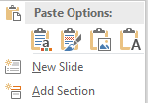
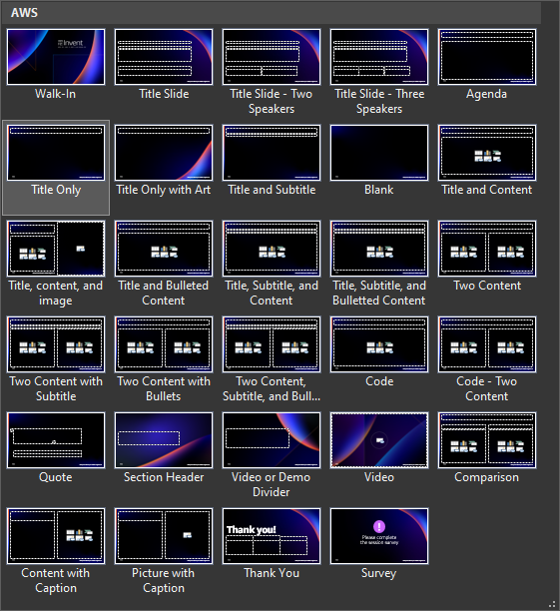
How to use this template
Follow these steps to use this template for to create a brand new slide deck:
Enter your content on the blank slides and delete any unneeded or hidden slides.
If you want to add more slides, on the Insert tab, select the little arrow under New Slide, and then select your desired layout from the options displayed (shown below). Fill out your slide content using the preformatted context placeholders.
End the deck with the Thank You slide and then the Survey Reminder slide.
Follow these steps to apply this template to your existing slide deck:
Select all of the slides in the left-hand pane of this template file and delete them (click on one and press Ctrl + A and then Delete).
Open the deck you’ve already created and select all of the slides in the left-hand pane (Ctrl + A) and copy them (Ctrl + C).
In the template file, right-click in the empty left-hand pane and click Use Destination Theme (use this same method to transfer individual slides).
For each slide in your deck, apply the appropriate layout (Home tab > Slides section > Layout).
Reset the slides (Home tab > Slides section > Reset) and ensure all content is in the appropriate placeholders and resets to the correct location. If needed, copy-paste the content into the correct placeholders.
Save the file and create/revise content as described to the left.
29 available slide layouts

Slide 29


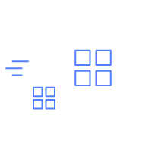

Icons, logos, diagrams, and images
Only use logos, icons, photos, screenshots, and illustrations that your company has permission (a license) from the copyright owner to use.
For diagrams, use font sizes of at least 12 pt. and lines of at least 1.5 pt. Label lines and icons for clarity where possible.
Keep slide diagrams as simple as possible; split content over several slides rather than forcing it all onto one.
Use simple, subtle animations as needed to direct audience attention and clarify relationships. Avoid dramatic transitions or animations (such as “Random Bars” or “Spin”).
Download AWS architecture icons from the AWS website
AWS speakers, download illustrations, icons, and AWS logos from the brand portal
AWS speakers, find licensed stock photography on Amazon Freeway

Slide 30
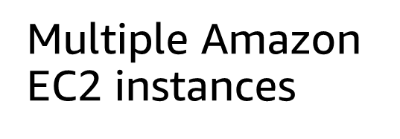
Typography
Font family
Only use the Amazon Ember font family (with the exception of code, which should use Lucida Console).
Use Amazon Ember Heavy for titles, sentence case (sentence-style capitalization).
Use Amazon Ember for slide text, sentence case.
Font styling
Do not underline text that is not a hyperlink.
Use font sizes that are at least 20 pt. for slide text and at least 12 pt. for diagrams.
Do these fonts match?
Multiple Amazon EC2 instances
If not, download and install the Ember font.

Slide 31
Additional resources
THESE ARE GENERAL PRESENTATION INDUSTRY RESOURCES AND ARE NOT ENDORSED BY AWS OR AMAZON
Microsoft PowerPoint Help & Learning site Essential basics on using PowerPoint from Microsoft
Nuts & Bolts PowerPoint Speed Training Hacks, shortcuts, and “hidden” features
BrightCarbon events Free webinars on PowerPoint design, presenter skills, and more
The Presentation Guru A blog site that focuses on presenter skills
The World of Presentations (podcast) Conversations with industry experts about PowerPoint design, mechanics, and presenting
The AIGA The professional association for design
Visme Blog posts on design, templates, and presenting
Are you an AWS speaker and want to do a deep dive into PowerPoint? Check out the Event Content Editor wiki for more resources.

